Slide 1
Object States, HQL, Pagination

Slide 2
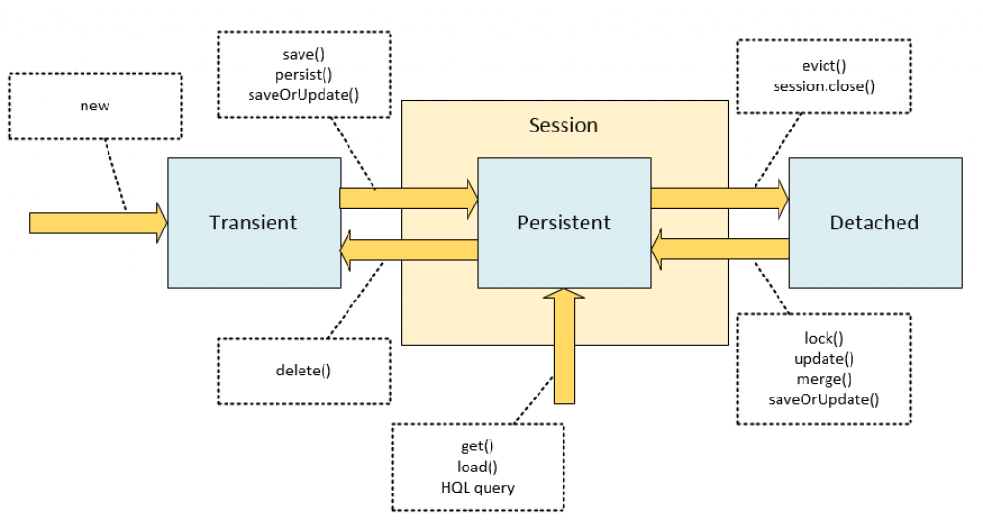
Object State Diagram

Slide 3
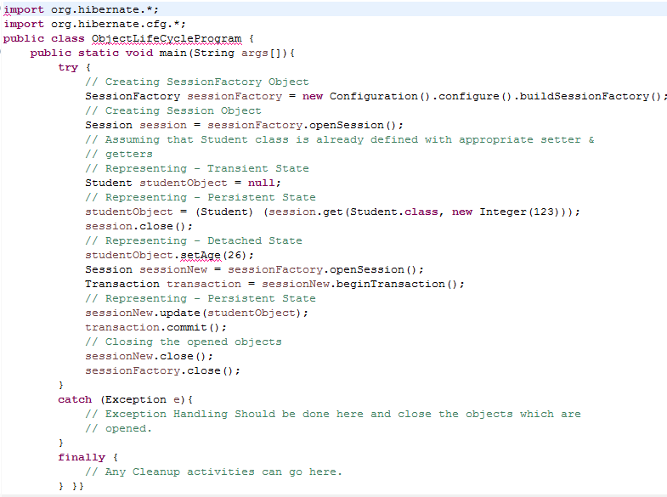

Slide 4
Transient(New) object
Transient - an object is transient if it has just been instantiated using the new operator, and it is not associated with any of the Hibernate Session(s).
Also, it has no persistent representation in the database and no identifier value has been assigned.
Transient instances will be destroyed by the garbage collector if the application does not hold a reference anymore.
Use the Hibernate Session to make an object persistent and let Hibernate take care of the SQL statements that need to be executed for this transition.

Slide 5
Persistent(Managed) object
Persistent – a persistent instance has a representation in the database and an identifier value.
It might just have been saved or loaded; however, it is by definition in the scope of a Session.
Hibernate will detect any changes made to an object in persistent state and synchronize the state with the database when the unit of work completes.
Developers do not execute manual UPDATE or DELETE statements when an object should be made transient.

Slide 6
Detached object
Detached – a detached instance is an object that has been persistent, but its Session has been closed.
The reference to the object is still valid, of course, and the detached instance might even be modified in this state.
A detached instance can be reattached to a new Session at a later point of time, making it persistent again. This feature enables a programming model for long running units of work that require user think-time. We call them application transactions, i.e., a unit of work from the point of view of the user.

Slide 7
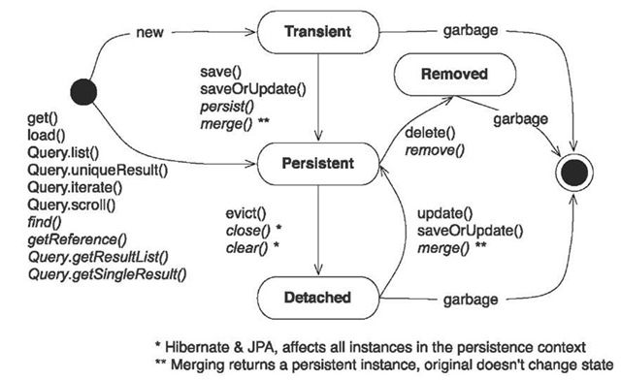
Working with Objects

Slide 8
Session Factory: -
Yes, Session Factory is Thread Safe: that is many threads can access it concurrently and request for sessions. It holds cached data that has been read in one unit of work and may be reused in a future unit of work.
SessionFactory is Hibernate’s concept of a single datastore and is threadsafe so that many threads can access it concurrently and request for sessions and immutable cache of compiled mappings for a single database.
A SessionFactory is usually only built once at startup. SessionFactory should be wrapped in some kind of singleton so that it can be easily accessed in an application code.

Slide 9
Session :-
No, Session is not Thread Safe. A Session is a light weight and a non-threadsafe object (No, you cannot share it between threads) that represents a single unit-of-work with the database. Sessions are opened by a SessionFactory and then are closed when all work is complete. Session is the primary interface for the persistence service. A session obtains a database connection lazily (i.e. only when required). To avoid creating too many sessions, ThreadLocal class can be used as shown below to get the current session no matter how many times you make call to the currentSession() method.

Slide 10
How to use Entity
If you are using openSession() then you have to use both DynamicUpdate and SelectBeforeUpdate to make it effective.
As openSession every time opens new session, any object you want to update, that object doesn't lies in that session so you have to use SelectBeforeUpdate to retrieve that object in session.
Then and then hibernate can determine how many fields are actually changed. So hibernate will update only changed field as we have set DynamicUpdate=true.

Slide 11
Dynamic-update
Hibernate allows you to use dynamic-update. It is optional and by default it is false.
When dynamic-update is true it means UPDATE SQL is generated at runtime and it contains those columns whose values have changed.
It tells Hibernate whether to include unmodified properties in the SQL UPDATE statement. If you are using simple update then all value is set .
It is good to use dynamic-insert or dynamic-update where huge number of columns in a table and you want to set value in some of them.
When you change only the value of a single attribute of an object we know that Hibernate makes an update query with all attributes and their respective values.
Example of scenario:
employee.name = “new name”;
emp.merge(employee);

Slide 12
Dynamic-update JPA Example
@Entity
@Table(name=“Employee")
@org.hibernate.annotations.Entity( dynamicUpdate = true)
public class Employee implements Serializable
{
// Instance Variables, Getters & Setters
}
@DynamicUpdate annotation allows them to be in the query only the fields that have changed.

Slide 13
Dynamic-update XML Example
<class table="Emp" catalog="example" dynamic-update="true">
<id name="EmployeeId" type="java.lang.Integer">
<column name="EmpId" />
<generator class="identity" />
</id>
</class>

Slide 14
Dynamic-Insert
This can improve the performance, mainly if you have a table with too many constraints or /and too many triggers. Updating only the affected columns will increase the performance. However, for the Hibernate makes a dynamic query has cost. So, you need measure in each case.

Slide 15
SelectBeforeUpdate
@Entity
@Table(name = "emp", catalog = "emp")
@DynamicUpdate , @SelectBeforeUpdate
class employee implements java.io.Serializable { }
You are using getCurrentSession() then no need to use SelectBeforeUpdate as object is already lies in session.
Use openSession() method instead getCurrentSession() because getCurrentSession automatically flush the session as well as close the session.
It may chance to face problem in getCurrentSession method. While in openSession we have to manage all the things.

Slide 16
Hibernate Query Language (HQL)
HQL is an abbreviation of Hibernate Query Language. It is a powerful query language, inspired by SQL that the Hibernate uses.
When looking a HQL it is as similar to SQL but the HQL is different from SQL, HQL is fully object-oriented and it supports inheritance, polymorphism, abstraction.
Queries in HQL are case-insensitive excluding the name of classes of java and the properties. for example in query WHerE is as same to whERe but a class name com.HibernateExample is not same as com.Hibernateexample.
The query operations are through objects. HQL acts as a bridge between Objects and RDBMS.

Slide 17
HQL queries statements / clause
select
from
where
group by
order by
insert
update
delete

Slide 18
HQL Query
” Query ” is an interface given in org.hibernate package. If we want to execute an HQL query on a database, we need to create a query object.
In order to get query object, we need to call createQuery() method in the session Interface.
Query q = session.createQuery("from Employee");

Slide 19
HQL Query Contd...
public int executeUpdate() : is used to execute the update and delete queries.
public List list() : returns the result of the select query as list.
public Query setFirstResult(int rowno): specifies the row no from where record will be retrieved.
public Query setMaxResult(int rowno): specifies the no of records to be retrieved from the table.
public Query setParameter(int position , Object value): It sets the value to the JDBC style query parameter.
public Query setParameter(String name , Object value): It sets the value to a named query parameter.

Slide 20
Ways to Write Query
from Employee as e
from Employee as employee
from Employee e
Fetching Complete Object :
select e from Employee e (or) from Employee e
Fetching Partial Object
select e.empId,e.name from Employee e [ or ]
select e from Employee e where e.name=:X [ or ]
from Employee e where e.name=? [ or ]
from Employee e where e.name=:X

Slide 21
Hibernate Parameter Binding
Parameter binding is the process of binding a Java variable with an HQL statement.Hibernate parameter binding is like prepared statements in any normal SQL language.
Example
String name="X";
Query query = session.createQuery("from Employee where employeeName = "+name+" ")

Slide 22
Parameter Binding
setParameter
Query query = session.createQuery("from Student where studentId = :id ");
query.setParameter("id", 5);
setString
String hql = "from Stock s where s.stockCode = :stockCode";
List result = session.createQuery(hql).setString("stockCode", "1234").list();
setProperties
Stock stock = new Stock();
stock.setStockCode("1234");
String hql = "from Stock s where s.stockCode = :stockCode";
List result = session.createQuery(hql).setProperties(stock).list();

Slide 23
Pagination
Hibernate is to divide the large result set into a number
of pages and fetching one page at a time is called
Pagination, Example
Query q = session.createQuery("select * from Student");
q.setFirstResult(3);
q.setMaxResults(5);
List list1 = q.list();

Slide 24
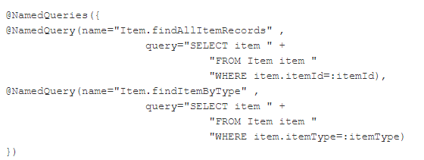
Named Queries JPA

Slide 25
Named Native Query
@NamedNativeQuery(name = "nativeSQL", query = "SELECT emp1.emp_id, emp1.name, emp1.manager_id, “ + "emp1.dept_id, emp1.address_id " + "FROM EMP emp1, EMP emp2 “ + "WHERE ((emp2.EMP_ID = ?) AND (emp2.EMP_ID = emp1.MANAGER_ID))", resultClass = Professor.class)

